Slide 1
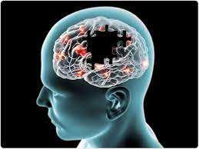
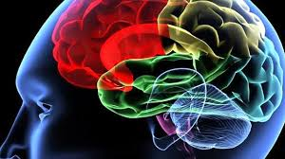
NeuroDiag - Alzheimer's Disease Detection using machine learning model
03/09/2023

Slide 2



Project Member
Mossa. Sumaiya Akter
Md. Saiful Islam
Irfanul Haque Nabil
Page#1
BKH2025017F
MUH2025033M
ASH1925021M
03/09/2023

Slide 3

Supervised By
Nazmun Nahar
Page#2
Lecturer
Institute of Information Technology
Noakhali Science and Technology University
03/09/2023

Slide 4
Table of contents
01
02
03
04
Problem Statement
Data Collection and Preprocessing
Introduction
Proposed Solution
05
06
07
08
09
Model Development and Evaluation(DIAGRAM)
Model (Software Development Methodology) & Tools
Project Structure/Design
Datasets
An Alzheimer’s affected brain
Result and Model Evaluation
Page#3
10
03/09/2023

Slide 5
Introduction
Page#4
Alzheimer’s disease is a brain disorder that slowly destroys memory and thinking skills and, eventually, the ability to carry out the simplest tasks. In most people with the disease — those with the late-onset type symptoms first appear in their mid-60s. Early-onset Alzheimer’s occurs between a person’s 30s and mid-60s and is very rare. Alzheimer’s disease is the most common cause of dementia among older adults.
The damage initially takes place in parts of the brain involved in memory, including the entorhinal cortex and hippocampus. It later affects areas in the cerebral cortex, such as those responsible for language, reasoning, and social behavior. Eventually, many other areas of the brain are damaged.
03/09/2023

Slide 6
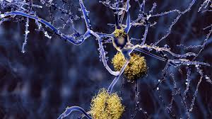
Page#5
Problem Statement
The current methods for Alzheimer's detection rely heavily on clinical assessment and cognitive testing.
These methods are subjective and may not accurately diagnose Alzheimer's disease in its early stages.
These tests are time-consuming, expensive, and require specialized expertise.
03/09/2023

Slide 7
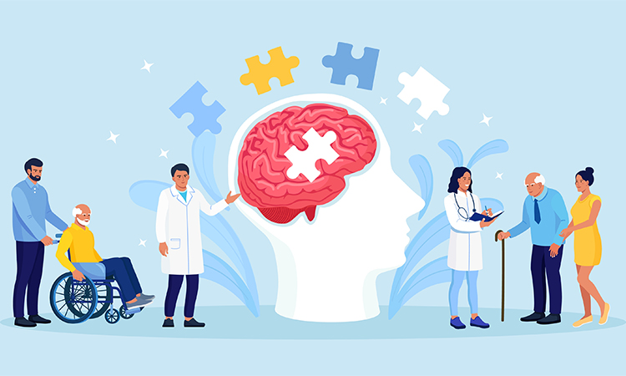
Proposed Solution
Page#6
A deep learning model based project called "NeuroDiag" for Alzheimer's detection using MRI images. The model will be trained on a large dataset of MRI images to identify patterns of brain atrophy and other structural changes associated with Alzheimer's disease.
Users will be able to upload MRI images of probable patients to a web application, which will then run the NeuroDiag model to predict whether the patient has Alzheimer's disease or not.
03/09/2023

Slide 8
Data Collection and Preprocessing
Page#7
MRI images will be collected from publicly available datasets such as ADNI and OASIS.
The MRI images will be preprocessed to remove noise, correct for bias field, and normalize the intensity values.
Additionally skull stripping and brain segmentation will be performed to isolate the brain tissue from the rest of the image.
The preprocessed images will be split into training, validation, and test sets.
he training set will be used to train the NeuroDiag model while the validation set will be used for hyperparameter tuning.
The test set will be used to evaluate the performance of the model.
03/09/2023

Slide 9
Model Development and Evaluation(DIAGRAM)
Page#8
A convolutional neural network (CNN) architecture will be developed for the NeuroDiag model. The CNN will take in MRI images as input and output a binary classification (Alzheimer's or not Alzheimer's).
Transfer learning will be used with pre-trained models such as VGG, ResNet, and Inception to improve the performance of our model.
Performance will be evaluated of the NeuroDiag model using metrics such as accuracy, precision, recall, F1 score, and area under the receiver operating characteristic curve (AUC-ROC).
03/09/2023

Slide 10
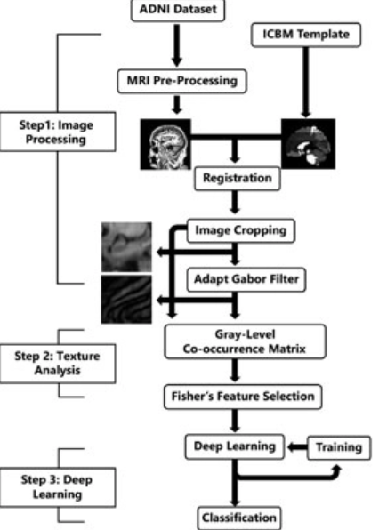
Model Development and Evaluation(DIAGRAM)
Page#9
03/09/2023

Slide 11
Model Development and Evaluation(DIAGRAM)
Page#10
Alzheimer’s detection using MRI scan
Pre- process-ing and feature selection
Convolution-al Neural Network model
Alzheimer’s disease detection
Performance Analysis
03/09/2023

Slide 12
Model (Software Development Methodology) &Tools
Page#11
Agile software development methodology will be used for this project.
Model Selection
Algorithms: [Convolutional Neural Network, Random Forest]
Hyperparameter Tuning
Tools
Trello
GitHub
JIRA
01/06/2013

Slide 13
Project Structure/Design
Page#12
The web application built using Flask, which is a lightweight web framework in Python. We used JavaScript libraries such as React and D3.js for data visualization and user interface design.
03/09/2023

Slide 14
Datasets
Page#13
ADNI
OASIS
03/09/2023

Slide 15
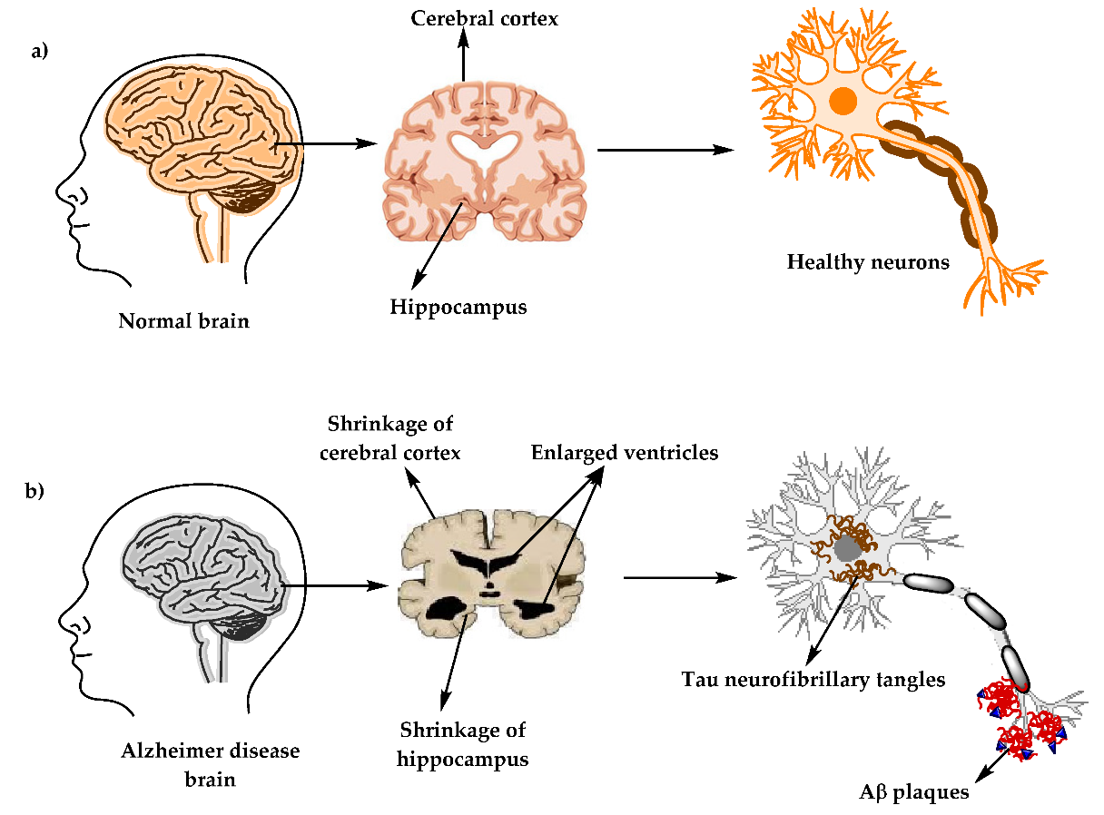
An Alzheimer’s affected brain
Page#14
03/09/2023

Slide 16
Result and Model Evaluation
Page#15
Results
Accuracy:
Precision:
Recall::
F1-Score:
ROC Curve
03/09/2023

Slide 17
Result and Model Evaluation
Page#17
Model Evaluation
Confusion Matrix
True Positives:
True Negatives:
False Positives:
False Negatives:
Performance Metrics
Accuracy:
Precision:
Recall:
F1-Score:
03/09/2023

Slide 18
References
Page#18
Using deep learning to investigate the neuroimaging correlates of psychiatric and neurological disorders: Methods and applications Neurosci. Biobehav. Rev. (2017)
Prevalence and incidence of Alzheimer’s disease in Europe: A meta-analysis Neurología (Engl. Ed.) (2017)
Ali, E.M., Seddik, A.F., Haggag, M.H.: Automatic detection and classification of Alzheimer’s disease from MRI using TANNN. Int. J. Comput. Appl. 148(9), 30–34 (2016)
Warsi, M.A.: The fractal nature and functional connectivity of brain function as measured by BOLD MRI in Alzheimer’s disease. (2012)
Liu, F., Shen, C.: Learning deep convolutional features for MRI based Alzheimer’s disease classification. arXiv preprint (2014) G. Mckhang
Report of the NINCDS-ADRDA work group under the auspices of department of health and human service task force on Alzheimer's disease Neurology, 34 (1984)
03/09/2023

Slide 19
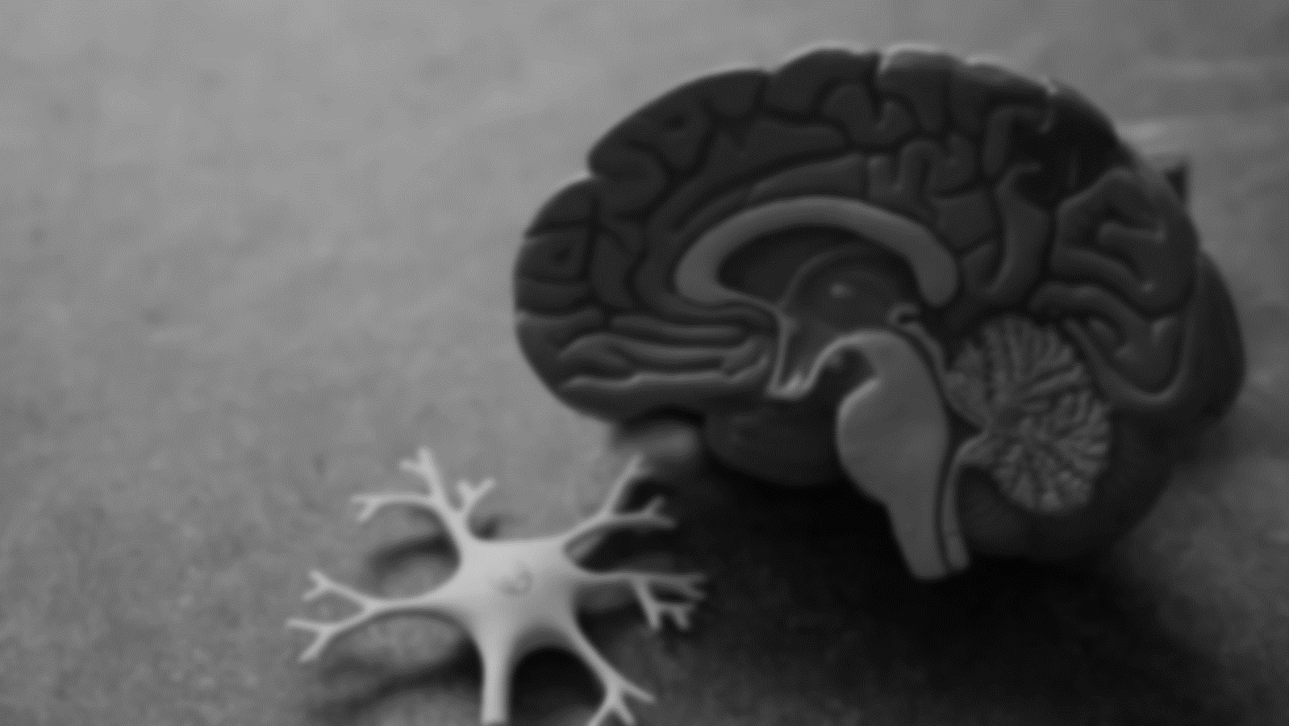
Thank You
Page#16
2
+
THANK YOU
03/09/2023

